Slide 1
Patterns in Software Development
Roopak Sinha and Quan Bai

Slide 2
So Far
Introduction to Software Architecture
The need
The concerns
The characteristics
Project proposals

Slide 3
Overview
Abstraction
Patterns
Patterns in software development
Architectural styles

Slide 4
Related Outcomes
Clearly document non-trivial software architectures.
Evaluate and discuss the properties of different software architectures.

Slide 5
What do we already know?
Abstraction
Design patterns
Architectural styles

Slide 6



Cost of Software Product
Every product has a cost
Where does the cost of software products come from?
Effort and time
How to reduce cost of software products?
Don’t waste our time and effort
Clear understanding of requirement
Efficient and effective communication
Don’t do the same thing for multiple times
Reuse…
Knowledge, design, code, solution,…

Slide 7
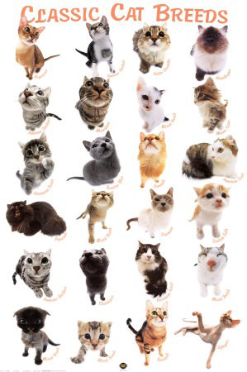
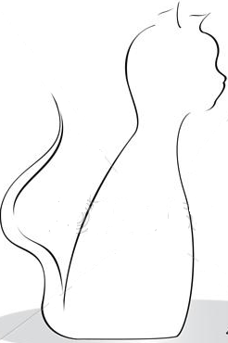

Abstraction
Abstraction is a process by which higher concepts are derived from the usage and classification of "real" or "concrete” concepts. It can help us to transfer and reuse our knowledge
Animal
Make them more abstract by removing conditions from the description (abstracting from an abstraction – or generalising the abstraction)
Make them less abstract by adding conditions to the description (refining or reifying the abstraction)
Create from a number of examples
Orange, fuzzy,
tabby cat
Create or find instances of the abstraction (instantiating the abstraction)

Slide 8
Some well-known abstractions in software development:
Abstractions you are already familiar with:
Classes
Abstract classes
Interfaces
…
Patterns are a kind of abstraction
More abstract
Interface/Abstract
Class
Instances
More concrete

Slide 9
Question
In your own words, define Abstraction.

Slide 10

Patterns
Pattern is a kind of abstraction
What are patterns?
Christopher Alexander: “Each pattern describes a problem which occurs over and over again in our environment, and then describes the core of the solution to that problem, in such a way that you can use this solution a million times over, without ever doing it the same way twice” (1979)
Patterns in software development:
A general reusable solution to a commonly occurring problem within a given context in software design.
A design pattern is NOT a finished design that can be transformed directly into code.
It is a description or template for how to solve a problem that can be used in many different situations.

Slide 11
Why do we need patterns?
Design and development are challenging tasks:
Balancing concerns, e.g. performance, adaptability, reliability.
Defining components and their interrelationships.
Thus experienced designers:
Rarely start from first principles
Look for similarities to problems solved in the past.
Apply a working "handbook" of approaches
Patterns can:
Make expert knowledge widely available
Supports focusing on the truly distinctive problems.
Enable more efficient communication, and promote better understanding by providing a useful working vocabulary for design

Slide 12
Patterns occur at every level of development.
Code level: Idioms
Subsystem Level: Design patterns
System Level: Architectural styles

Slide 13
Idioms (code level)
Idioms (language): a construction of words or a phrase that means something different than what the words are literally saying, e.g., “to throw in the towel”
Idioms (programming): an expression of a simple task or algorithm that is not a built-in feature in the programming language being used, or, conversely, the use of an unusual or notable feature that is built in to a programming language
Example:
j++;
++j;
j*=3;
…

Slide 14
Example 2: visit elements in a collection
Option 1
int n = collection.size();
for(; n > 0; n--) {
Integer next = (Integer) collection.get(n-1);
}
Option 2
Iterator it = collection.iterator();
while(it.hasNext()) {
Integer next = (Integer)it.getNext();
}
People implement the same idiom over and over again, so they say 'why can't we make the writing costs lower?‘ So the language designers incorporate a special bit of syntax:
Iterating a collection in Java 5:
Option 2 is idiomatic. People have documented the fact that they prefer to use this approach because it:
Is easier to write without making a mistake
Works better if concurrent modifications are a possibility
for( int next : collection)
…

Slide 15
Design patterns (subsystem level)
Exam-relevant
There are many types of design patterns for different kinds of problems. E.g.:
Creational patterns: about constructing objects
Structural patterns: about structure and relationships among entities
Behavioural patterns: about (simple) algorithms

Slide 16
Singleton pattern:
Problem: we want to allow ONLY ONE single instance of a class can be created inside our application, e.g., a log file
Solution:
Provide a default Private constructor
Create a Method for getting the reference to the Singleton Object
Make the Access method Synchronized to prevent Thread Problems
Override the Object clone method to prevent cloning
public static synchronized SingletonClass getSingletonObject() {
if (singletonObject == null) {
singletonObject = new SingletonClass(); }
return singletonObject;
}
public Object clone() throws CloneNotSupportedException {
throw new CloneNotSupportedException();
}

Slide 17


Adapter pattern:
Problem:
We want two unrelated interfaces can work together
Allows classes to work together even though they expect incompatible interfaces.
Solution: convert the interface of a class into another interface clients expect. Adapter lets classes work together that couldn’t otherwise because of incompatible interfaces.
Adaptee
+methodB();
Client
Adaptor
…
adaptor.methodA();
…
+adaptor: Adaptor
+adaptee: Adaptee
+doWork();
+methodA();
…
adaptee.methodB();
…

Slide 18
Example: a legacy Rectangle component’s display() method expects to receive “x, y, width, height” parameters. But the client wants to pass “upper left x and y” and “lower right x and y”.
LegacyRectangle
Client
+draw(x, y, width, height);
+draw(x1, y1, x2, y2);
Rectangle
+draw(x1, y1, x2, y2);
public void draw(int x1, int y1, int x2, int y2)
{
LegacyRectangle.draw(Math.min(x1, x2), Math.min(y1, y2),
Math.abs(x2 - x1), Math.abs(y2 - y1));
}

Slide 19
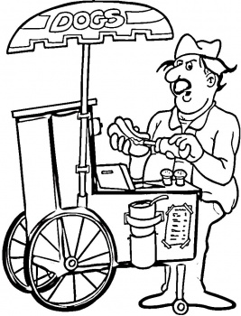

Mediator pattern:
The problem:
We have multiple loosely coupled classes, which interact with each other
We add more classes and they still interact with each other but it gets really difficult to maintain
Example:

Slide 20

Mediator pattern takes care of this problem.
It promotes loose-coupling of classes such that only one class (Mediator) has the knowledge of all the classes
Rest of the classes have their responsibilities and they only interact with the Mediator
Example: http://www.avajava.com/tutorials/lessons/mediator-pattern.html?page=1
20

Slide 21
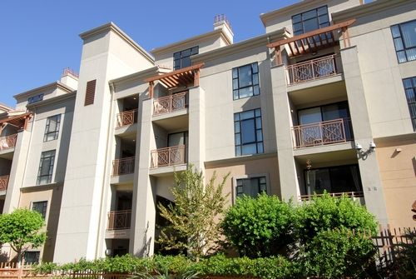
Architectural styles
Exam-relevant
What is a style and why do we need it?
What caused NZ leaky home crisis?
The Building Act 1991 reduced controls and standards…
Many developers, builders and architects involved knowingly or carelessly constructed buildings with numerous faults and short-cuts.
The changes also coincided with architectural design trends towards Mediterranean-style flat roofs (a traditional dry-climate design), low-angle monopitch roofs and buildings without eaves.
From the OX dictionary:
a particular procedure by which something is done ; a manner or way
a distinctive appearance, typically determined by the principles according to which something is designed
21

Slide 22
An architecture is the fundamental organization of a system embodied by
Its components
Their behaviours
Their relationships to each other and to the environment
An architectural style is a coherent set of design decisions concerning the architecture
a combination of a typical (de)composition
and typical choices for connectors, components (building blocks) and behavior
An architectural style, sometimes called an architectural pattern, is a generic solution for a class of problems. It provides an abstract framework for a family of systems
An architectural style improves partitioning and promotes design reuse by providing solutions to frequently recurring problems

Slide 23
Define an architectural style
Motivation (guidelines, context) for the application of the style
which extra-functional properties are achieved, and how
which problem class is solved
Vocabulary
Names for components(building blocks) and connectors, and for other concepts
Rules (constraints, responsibilities) for components and connectors
Generic structure and behavior
Interfaces of components, and correspondent connectors
Data distribution, protocols, control flow, data flow
When applied, a style yields a partial architecture
In fact: styles classify architectures
Within an architecture, several styles can be applied and also, several alternatives in interaction style

Slide 24
Client-server style:
Motivation:
Sharing some localised resource (e.g. file store, compute server)
Protecting and managing content (e.g. a database)
Delay binding, decrease dependencies (independent development)
Vocabulary
Client, server (building blocks)
Request, reply (interaction)
Server discovery
Rules:
Server:
provides a service according to the above motivations
Passive, awaiting requests from clients, does not know clients
Handles data access, data integrity
Client
Active, initiates activity, discovers server
No connection among clients

Slide 25
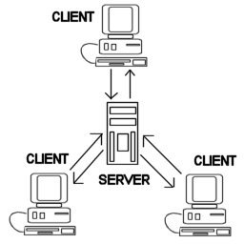
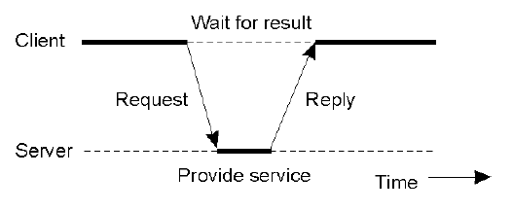


Structure:
Typical behaviour:
Client finds server access point through discovery
Regular interaction
Example:
ATM (client)
ATM (client)
ATM (client)
Bank (server)

Slide 26
Layered style
Layer N
Motivation:
Independent layers of abstraction
separate concerns, limit dependencies, allow replacement
Vocabulary
Layer (building block), service, interface
Call, call-back (interaction style)
Rules
Layer N may know only layer N-1
Layer N may not use knowledge of lower layers than N-1
Control flow can be both synchronous and asycnhronous (“event”, “call-back”)
Structure:
Layer N-1
Response flow
Request flow
Layer 2
Layer 1
Typical behaviour:
(Objects in) layer N call upon the API of (objects in) layer N-1
Layer N registers call-back routines with layer N-1
26

Slide 27
Features of layered styles
Good:
Clear dependence structure
Components in different layers are independent
Cautions: System with many layers can be inefficient
Typical uses: Operation systems, network protocol stacks
27

Slide 28
Repository-based architectures
A repository architecture consists of a central data structure (often a database) and a collection of independent components which operate on the central data structure

Slide 29
Blackboard architectures (a classic repository architecture ):
Motivation:
A system needs to handle different tasks
A number of system components (called partners) do not know each other
Tasks are coupled only through the shared state;
Vocabulary:
Knowledge sources: a set of problem solving modules
Blackboard (BB): a common global database
Hypothesis: the contents of the BB
Rules
Knowledge sources respond to changes on the BB, and interrogate and subsequently directly modify the blackboard
It is therefore through the blackboard that the knowledge sources communicate and cooperate.

Slide 30
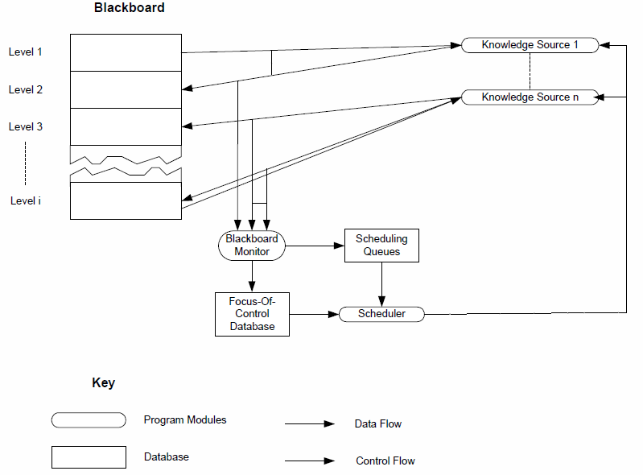
More complex blackboard:
Hypotheses can be classified to different levels or classes
Each knowledge source responds only to a certain class/level of hypotheses
Mediators and schedulers to facilitate hypotheses searching or allocation
30

Slide 31




Benefits of BB architecture:
Flexibility of configuration: knowledge sources are loosely coupled and not tied to the BB
Multiple problem solvers (enable the selection of knowledge sources)
Management of multiple levels of abstraction: both the BB and knowledge resources can reflect the hierarchy
Can enable cooperative problem solving
Drawbacks of BB architecture
Global database
Computational complexity of cooperation
Cannot guarantee that tasks can be accomplished
V1
V2
V3

Slide 32

Case-based reasoning (CBR) (another classic repository architecture ):
Not only an architecture style but also a computer reasoning technique
Case Base
Task
Case Law
≈
Case
Case
Case
Case
Case
32

Slide 33
Processes in CBR
Retrieve the most similar case (or cases) comparing the case to the library of
past cases
Reuse the retrieved case to try to solve the current problem
Revise and adapt the proposed solution if necessary
Retain the final solution as part of a new case
Advantages:
Iterative development
Improves over time as case base grows
Also allows multiple knowledge resources
Disadvantages
May have bad performance at the beginning
Require intelligence to “fix” solutions
Require good knowledge representation (for cases & tasks)
33

Slide 34
Pipes & filters style
Motivation:
Systems that work with streams of data (e.g. video processing multimedia systems)
Streams of data are naturally processed in several stages
Reconfigurable system: stages inserted/removed/reordered easily
Vocabulary
Pipes
Filters
Data
Sink, buffers, pipeline, data stream.
Typical behavior
Filters designed to be reusable
Forks and joins are allowed, but pipeline is sequence of filters from data source to sink.

Slide 35
Structure and rules:
Each component has inputs and outputs. A component reads streams of data on its inputs and produces data on its outputs, continuously as data are coming in.
Filters: components compute by performing local transformations on their inputs to produce their outputs
Pipes: the connectors of components transmit the outputs of one component to the inputs of another
35

Slide 36
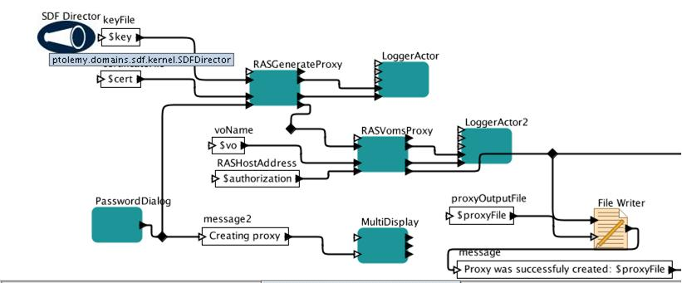
Strengths of pipes and filters:
Makes it easy to understand overall function of the system as a composition of filter functions
Easy to maintain
High transparency
Weaknesses:
Data transmission critical for system performance
Often leads to batch-type processing
Not good for interactive applications
Hard to coordinate stream inputs
Example: Kepler workflows
Dynamic, changeable, un-predictable inputs
36

Slide 37
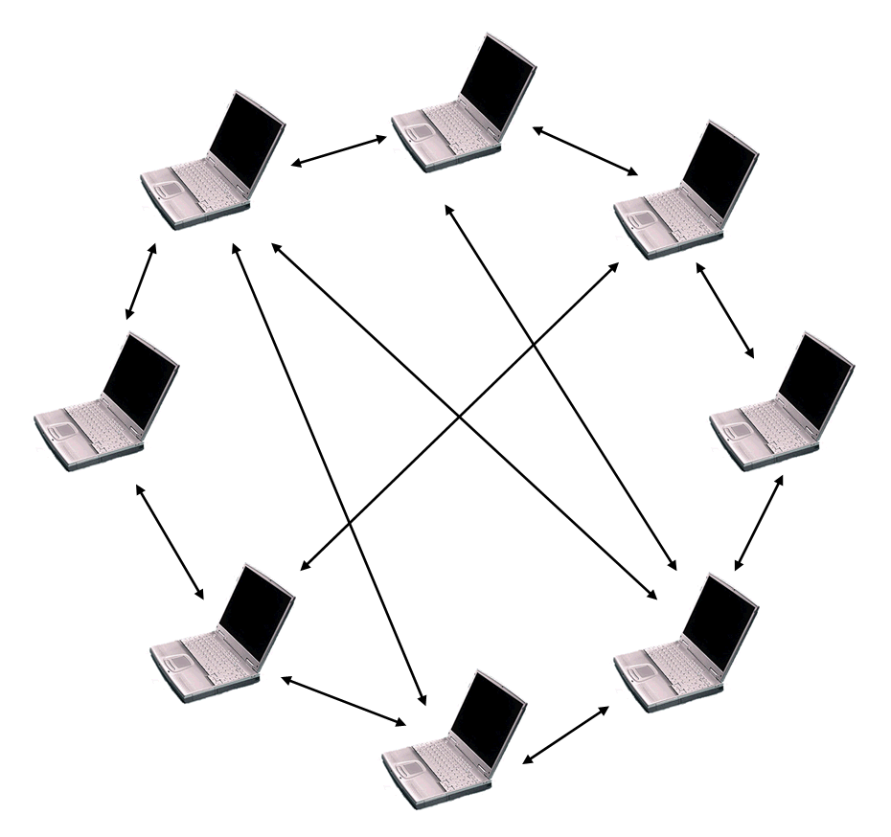
Peer to Peer Style
Motivation:
Sharing resources and content
Cooperation in communities
Symmetry in roles
Increase concurrency
Vocabulary
Peer, super peer
Community (of peers)
Rules
Peer:
Symmetric in functionality, and contribution can discover, reach and cooperate with all other peers, in principle can be both passive and active
Super peer
Peer that contributes extra resources to the community (extra services, like directory, discovery)
In addition:
Peers can finds community access point and join a community; provides passively services to other peers; and actively uses services from peers in the community
The collective services of peers result in new functionality

Slide 38
Discussion: style & architecture design
Again, what is a style?
Styles represent hard-won wisdom in system development
Does that means we can rely on them?
Do you know any other architectural styles?
38

Slide 39
Styles limit the designer in several ways:
The amount of detail or the number of concepts that the designer is allowed to deal with may be limited (e.g., client-server)
The way elements of the design are allowed to interact may be restricted (e.g., mediator based architecture)
The style may constrain the solution of some sub problems to be addressed in a less than optimal way
39

Slide 40
Where then does the effectiveness of styles come from?
Help us to focus
Code generation and framework implementation strategy
Reuse
Enable more efficient communication, and promote better understanding
How to make better use of styles?
Combination
Modification
Creation
Example: P2P and BB?
40

Slide 41
Homework
Brainstorm about the styles suitable for your topic.
Different styles can provide different benefits.

Slide 42
Readings
http://en.wikipedia.org/wiki/Software_architecture_styles_and_patterns#Catalog_of_architectural_styles
Find research articles on architectural styles for your own project domain on Google Scholar or other scientific databases

Slide 43
Questions
43

